Slide 1
As you take your seats
Get out your clickers
Set them to channel 22

Slide 2
Endocrine Pancreas: Histology and Physiology
Dave Bridges, PhD
dbridge9@uthsc.edu
Notes:
Talk about notes, quizes, chatting

Slide 3
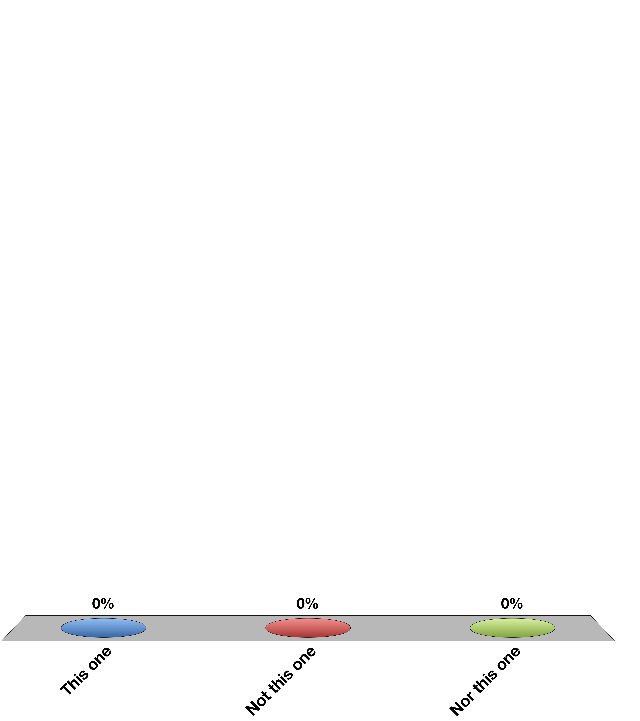
Select “A”
This one
Not this one
Nor this one
Response Counter
15

Slide 4
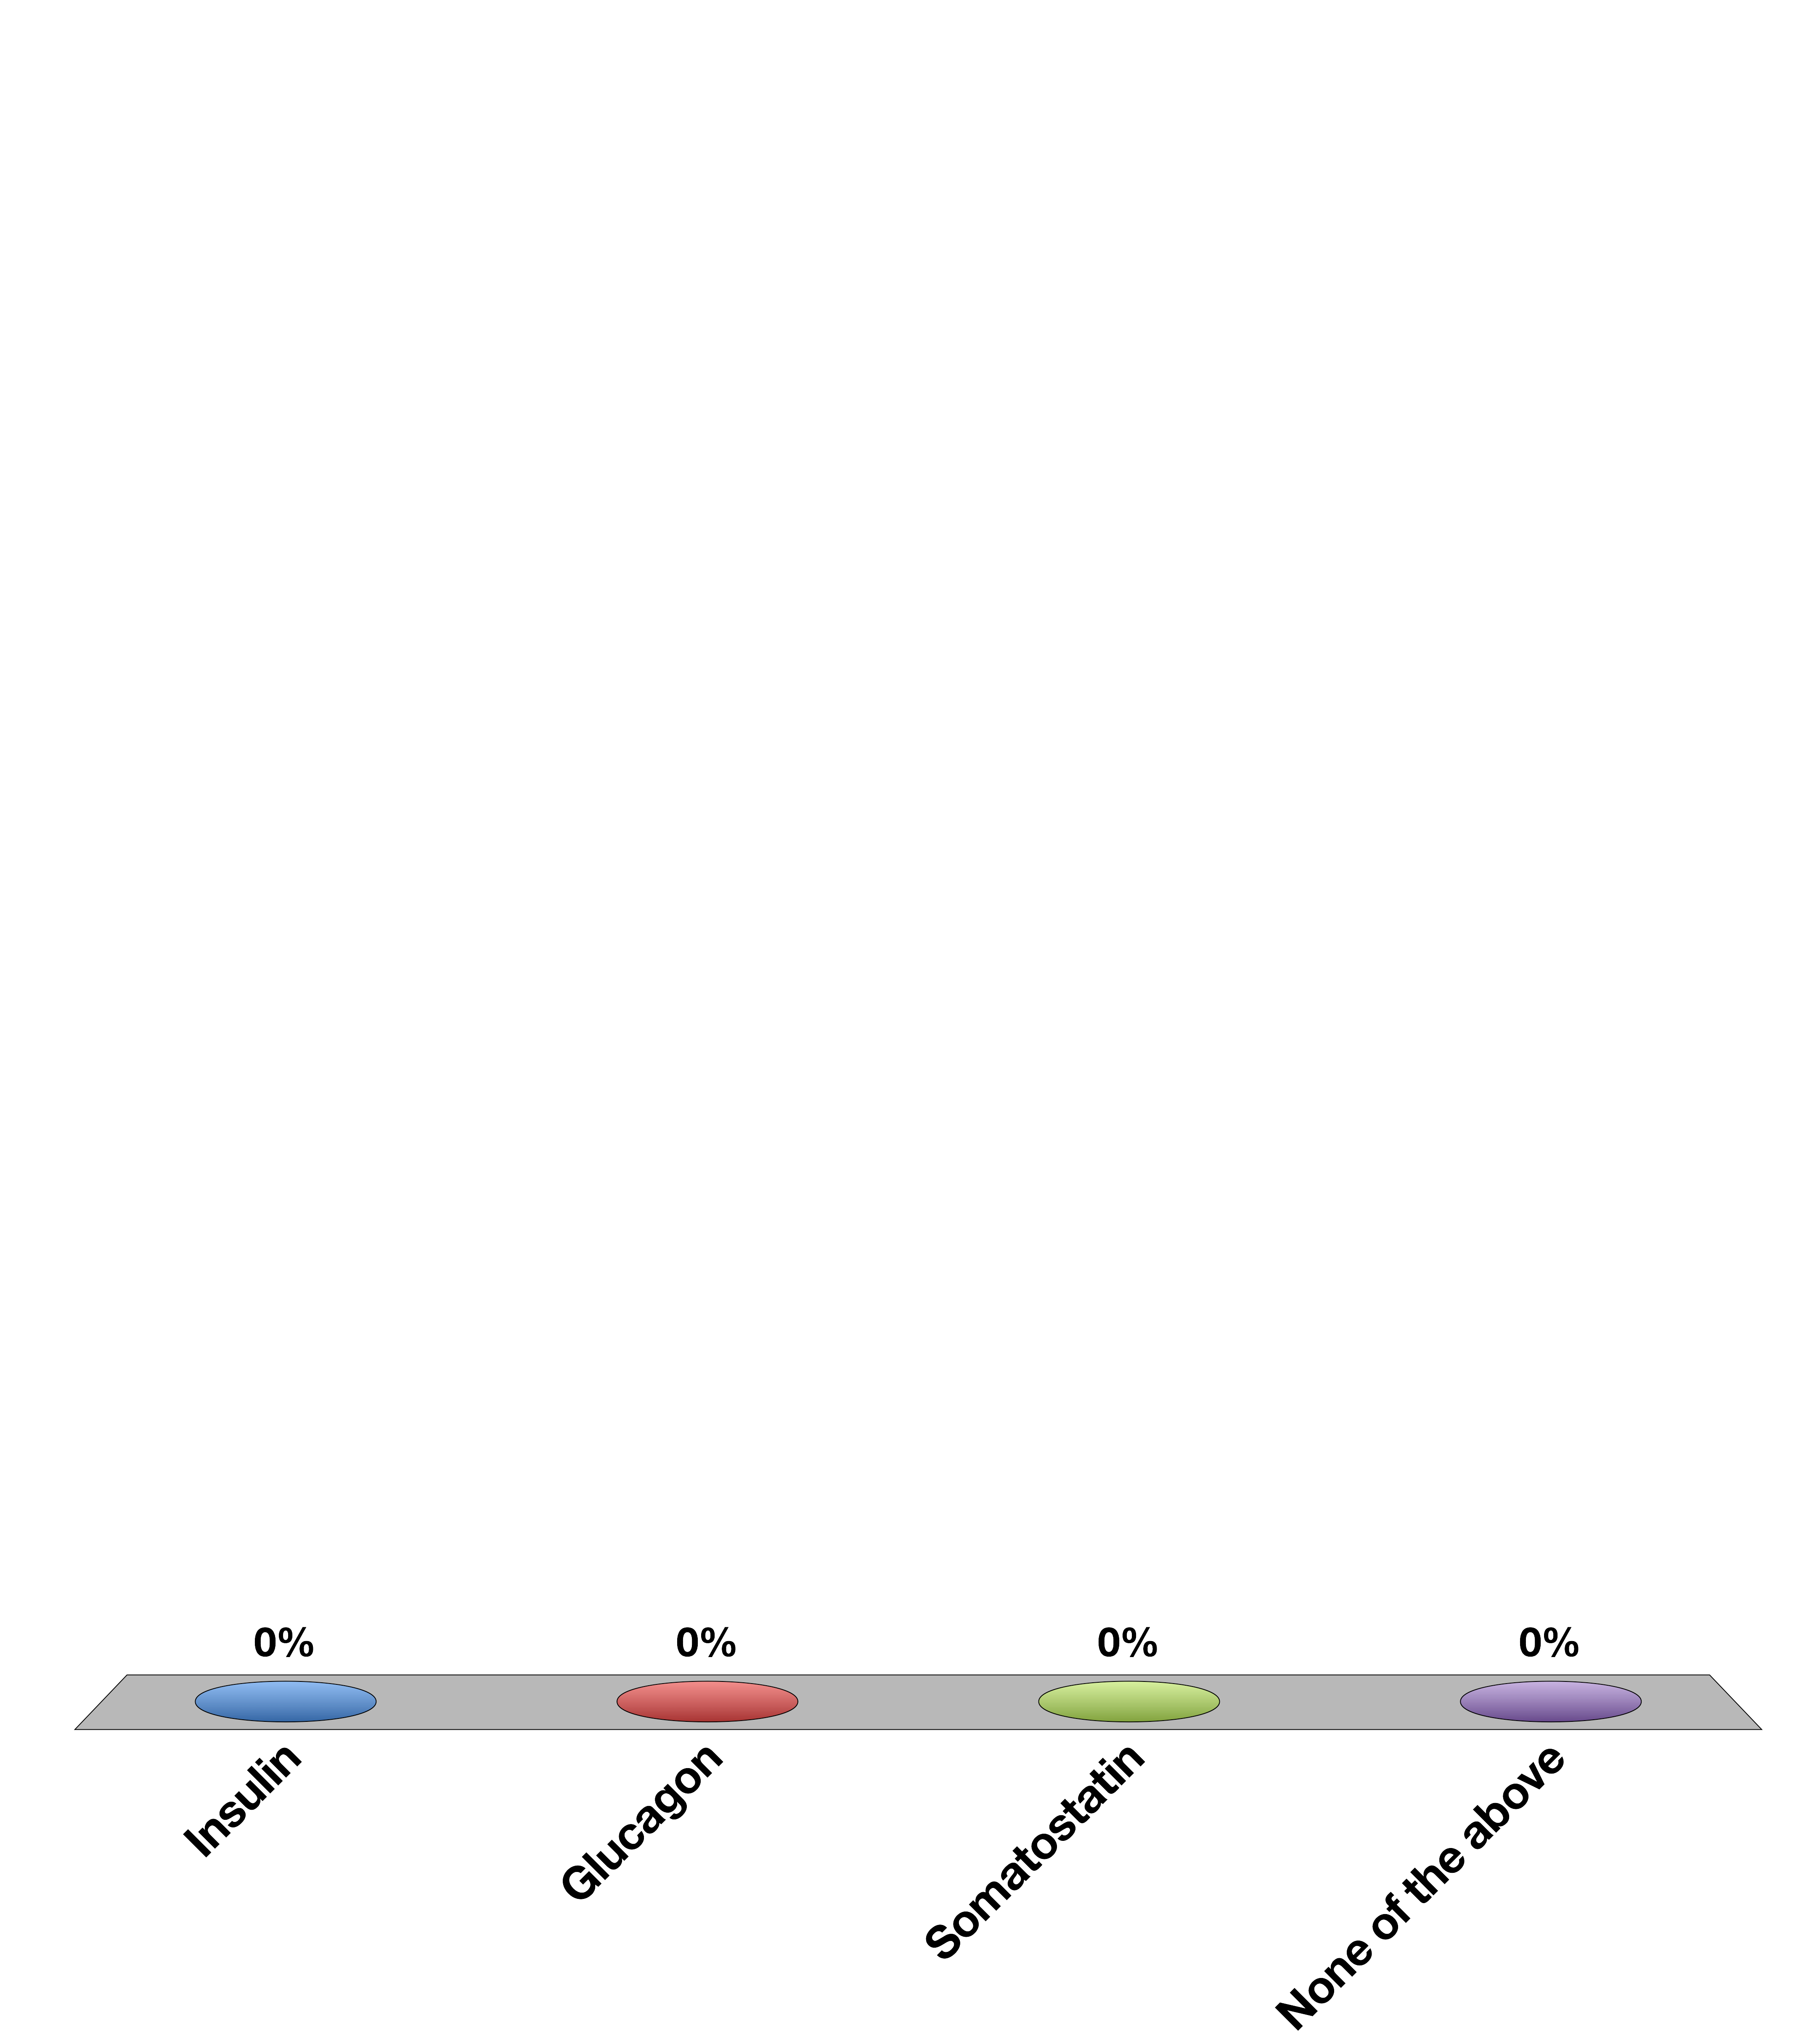
What hormone is secreted from the pancreatic alpha cell
Insulin
Glucagon
Somatostatin
None of the above
15

Slide 5
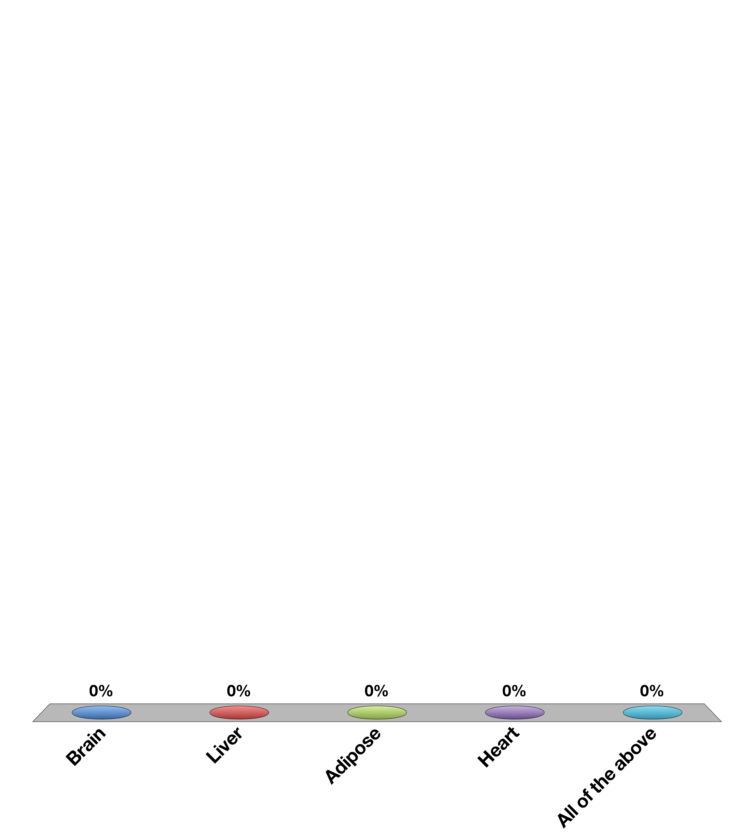
Which tissue exhibits insulin stimulated glucose uptake
Brain
Liver
Adipose
Heart
All of the above
15

Slide 6
What is the main target tissue for glucagon?
Brain
Liver
Adipose
Heart
All of the above
15

Slide 7
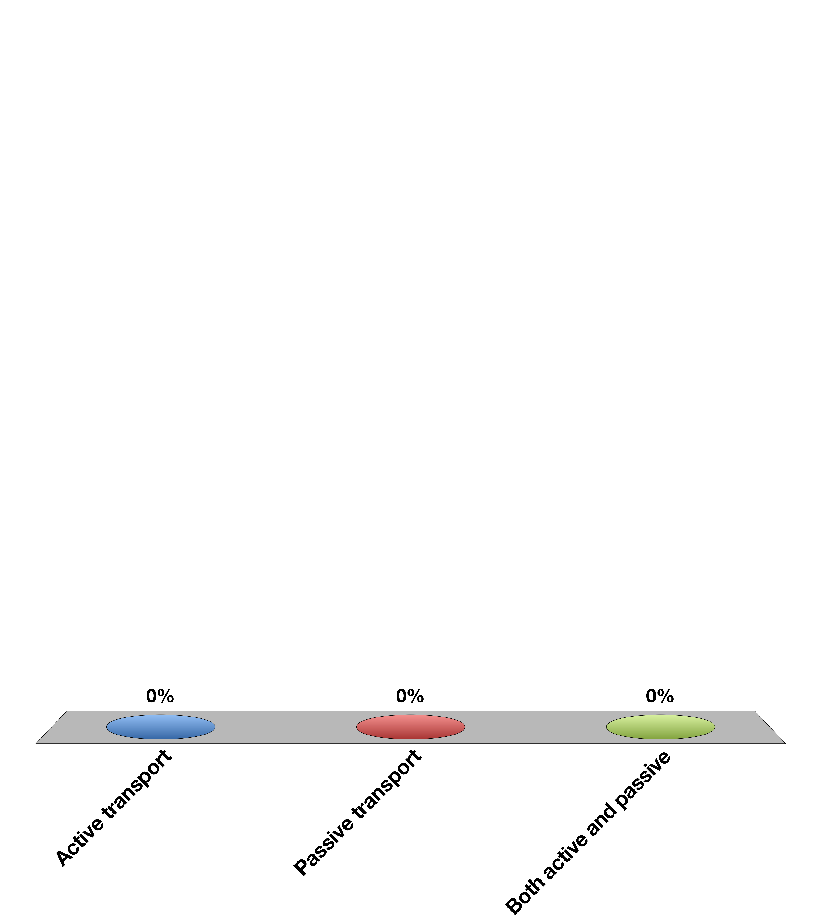
Insulin Stimulated Glucose Uptake is
Active transport
Passive transport
Both active and passive
Response Counter
15

Slide 8
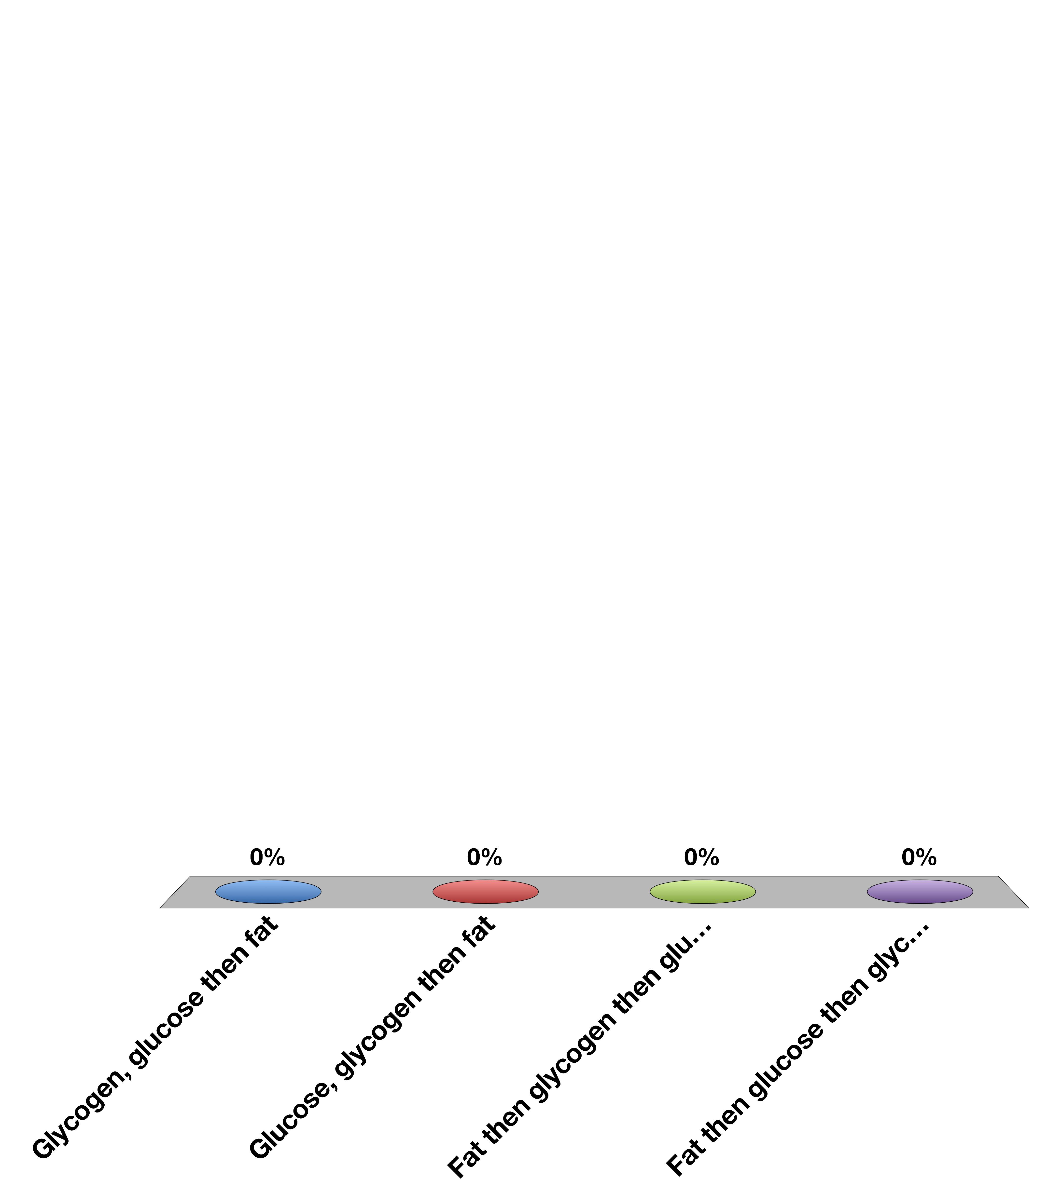
What order are these metabolites used
Glycogen, glucose then fat
Glucose, glycogen then fat
Fat then glycogen then glucose
Fat then glucose then glycogen
15

Slide 9
Learning Objectives
Name the cell types of the Islets of Langerhans and name the hormones secreted by them.
Describe the main targets and functions of glucagon.
List the major factors that stimulate or inhibit glucagon and insulin.
Describe the important physiological roles of insulin.
List the major actions of insulin in muscle, adipose tissue, and liver.
Explain briefly the mechanism of glucose uptake into the muscle.
Name the tissues in which insulin facilitates glucose uptake and those in which insulin does not facilitate glucose uptake.
List the major factors that stimulate or inhibit insulin secretion.
Draw an oral glucose tolerance test (oGTT) (glucose, insulin, and glucagon levels) and and describe what is occurring and why. Explain how the two hormones act to promote glucose homeostasis in the plasma.
State which nutrient storages are preferably used for short-term regulation of energy metabolism if no nutrients are available from the GI tract.
Discuss the hormones involved, fuel storage capacity, fuel storage consumption, and glucose (or fatty acid) levels during 1) the postprandial period, 2) the post-absorptive period, 3) fasting.
List the insulin-counteracting hormones and their roles in glucose homeostasis. Discuss the hormones involved in minute-to-minute regulation and long-term regulation of glucose homeostasis.

Slide 10
Diabetes Mellitus
One of the first described diseases (1500 BC)
Named diabetes by Appolonius of Memphis (Egypt)
Diabetes (to pass through)
Mellitus (from honey)

Slide 11
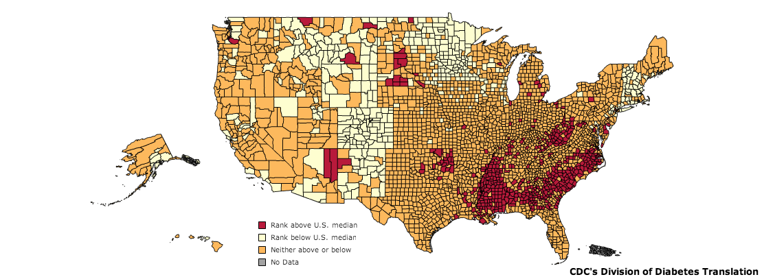
Diabetes in the United States
CDC, 2010
Notes:
As of 2011, diabetes affects 25.8 million people or 8.3% of the population. This includes approximately 7 million undiagnosed individuals. In addition to this, 79 million Americans over the age of 20 are estimated to be pre-diabetic. As of 2007, diabetes is estimated to cost $116 billion in direct and $58 billion in indirect costs [@CDC2011].
Diabetes is especially prevalent in this region. As shown in the map, there is a higher percentage of diabetics in the mid and deep south regions of the United States.

Slide 12
Glucose Regulation

Slide 13


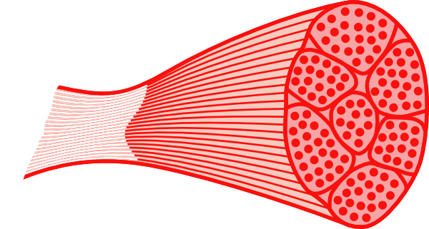
Regulation of Blood Glucose Levels
Gluconeogenesis
Disposal
Glucose Uptake
Glucose Storage
Glucose Utilization
Glucose Production
Glucose Uptake
Glucose Storage
and Utilization
Notes:
Ask for some examples of how glucose is stored, or how it is utilized

Slide 14
Making More Glucose
Consuming carbohydrates
Gluconeogenesis
Glycogenolysis

Slide 15
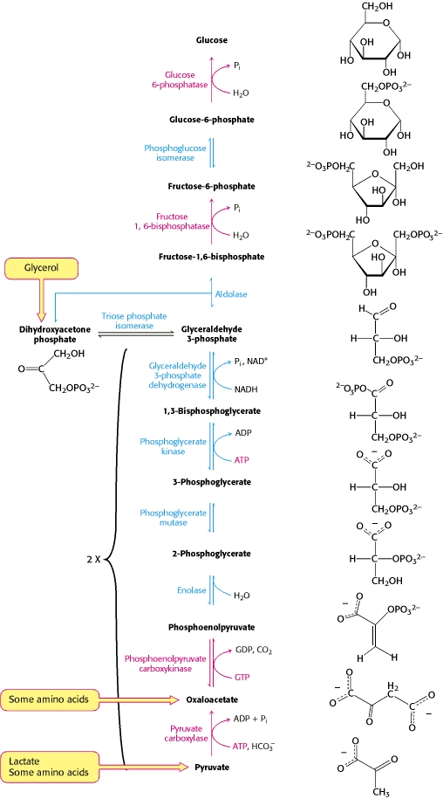
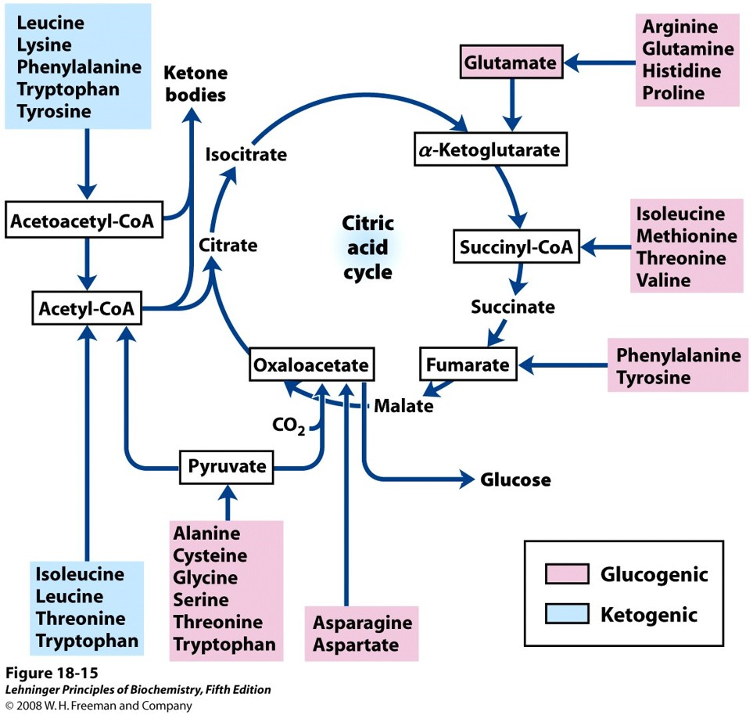
Gluconeogenesis
Primarily occurs in the liver
Uses amino acids and fatty acids to generate glucose
Notes:
Where does this mainly occur

Slide 16
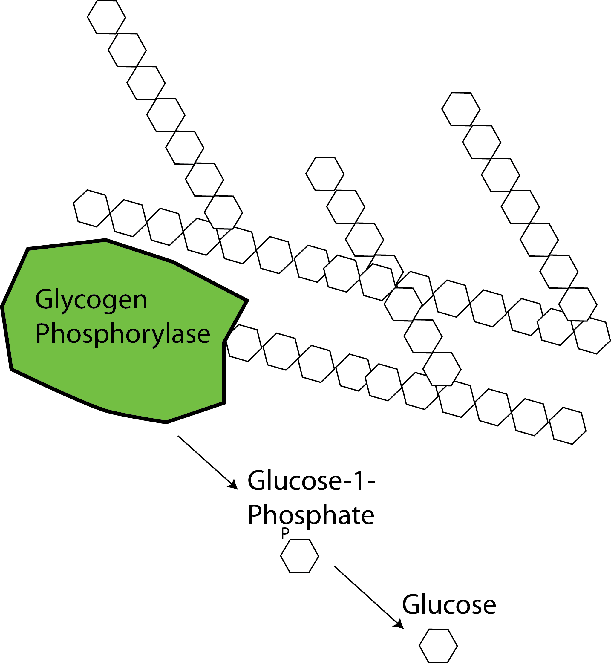
Glycogenolysis

Slide 17
Removing Blood Glucose
Glucose Oxidation
Glucose uptake
Glycogen and Lipid Synthesis

Slide 18
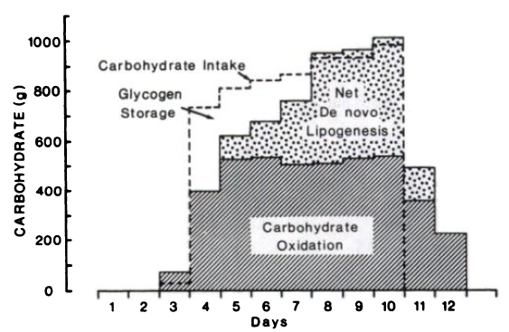
Responses to Overfeeding
K. J. Acheson, Y. Schutz, T. Bessard, K. Anantharaman, J. P. Flatt, E. Jequier, Glycoprotein storage capacity and de novo lipogenesis during massive carbohydrate overfeeding in man Am. J. Clin. Nutr. 48, 240–247 (1988).

Slide 19
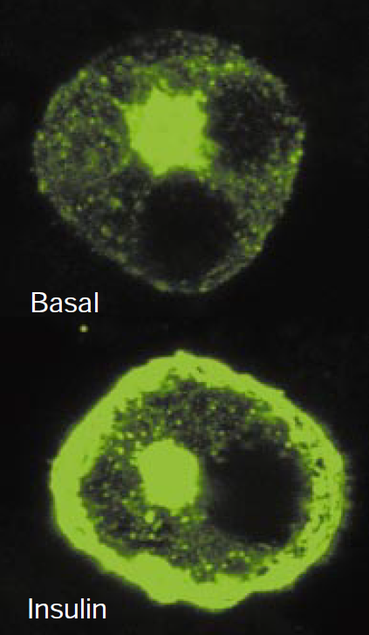
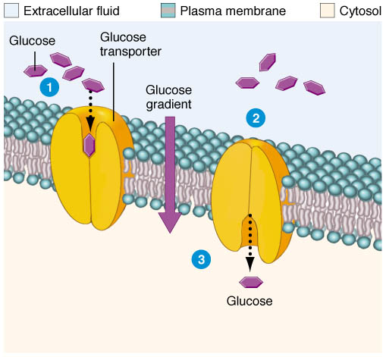
Glucose Uptake
Non-Stimulated Glucose Uptake
Stimulated Glucose Uptake
Brain
Liver
Kidneys
Fat
Muscle
GLUT4-eGFP
From Saltiel and Kahn (2001) Nature 414:799-806
From http://classroom.sdmesa.edu/eschmid/Chapter3-Zoo145.htm

Slide 20
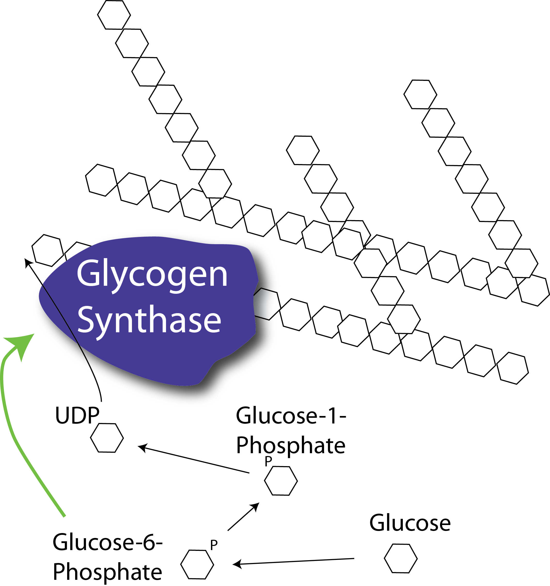
Glycogenesis
Notes:
Rate limiting step is the regulation of glycogen synthase activity.
Allosterically activated by Glucose-6-Phosphate, which is increased during glucose uptake and glycolytic flux

Slide 21
Order of Fuel Utilization/Storage
Energy Production (Fasting)
Fuel Storage (Fed)
Creatine phosphate
Glycolysis
Glycoge
Gluconeogenesis
Fat Oxidation
Glucose uptake/oxidation
Glycogenesis
Lipogenesis

Slide 22
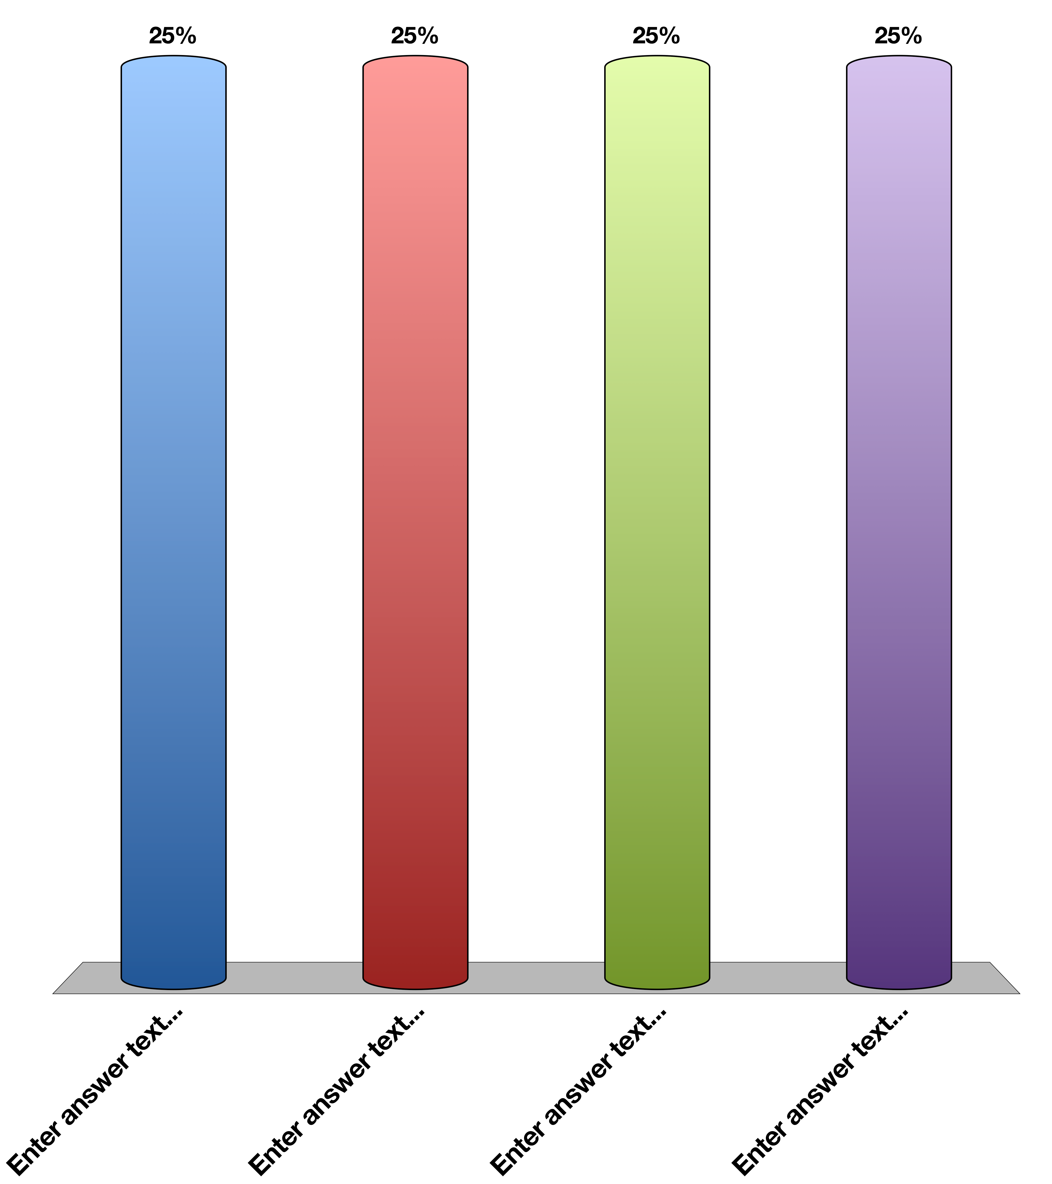
What would happen if you are unable to store glucose only in adipose
Obese, hyperglycemic
Obese, hypoglycemic
Lean, hyperglycemic
Lean, hypoglycemic
Response Counter
15

Slide 23
Mechanisms to Reduce Blood Glucose

Slide 24
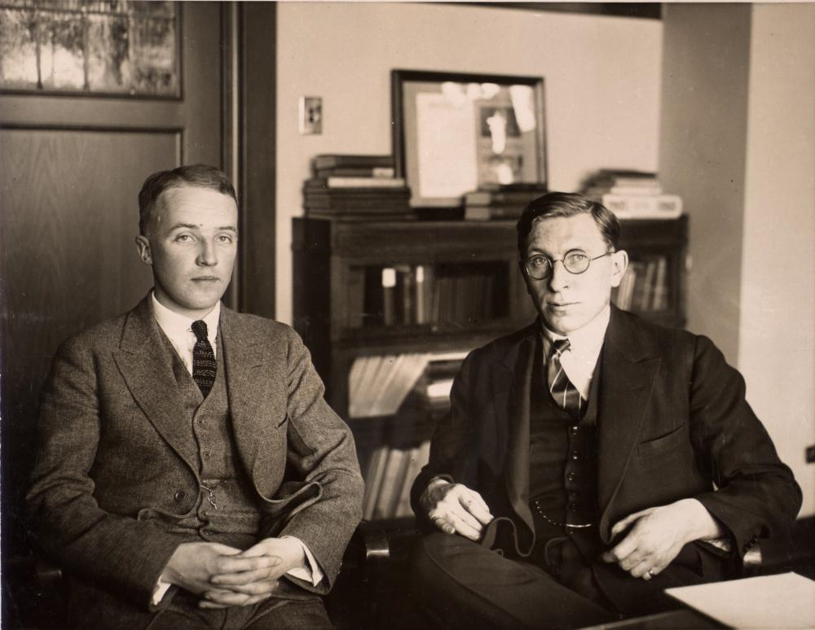
The Discovery of Insulin
Notes:
1889 von Mering and Minkowski (Pancreatectomy mimics disease)
Banting was a surgeon adept at pancreatectomizing dogs, Best was a lab technician who was very good at measuring blood glucose. MacLeod provided them lab space at the University of Toronto

Slide 25
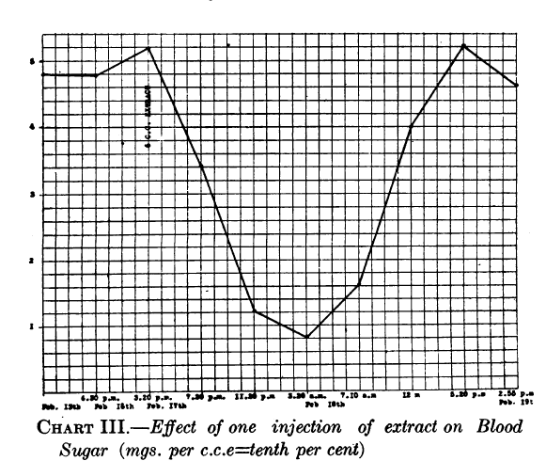
The Discovery of Insulin
Banting et al. 1922
Notes:
Insulin was discovered by Frederick Banting and his colleagues at the University of Toronto in 1921. They performed experiments in which they injected extracts
from pancreas fractions into dogs which had their pancreas’ surgically removed. They showed that a secreted substance from the pancreas lowered blood glucose
in these dogs (Frederick G. Banting and Best 1922). This is an image of dog pancreas isolate injected into a diabetic child

Slide 26
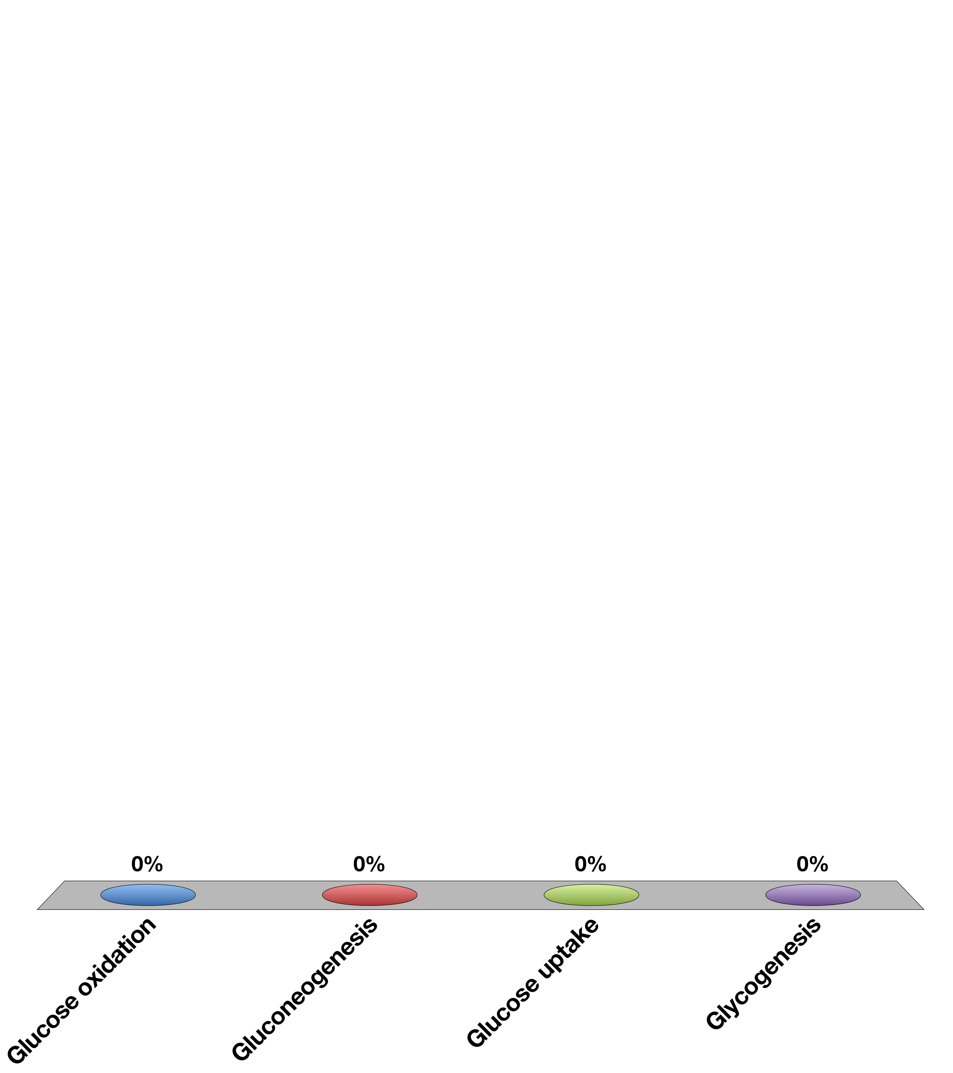
Which of these should insulin block?
Glucose oxidation
Gluconeogenesis
Glucose uptake
Glycogenesis

Slide 27
Think and discuss
A patient has no insulin response in the liver, what should be the effects on
Blood glucose
Lipid storage
Insulin levels
Obesity

Slide 28
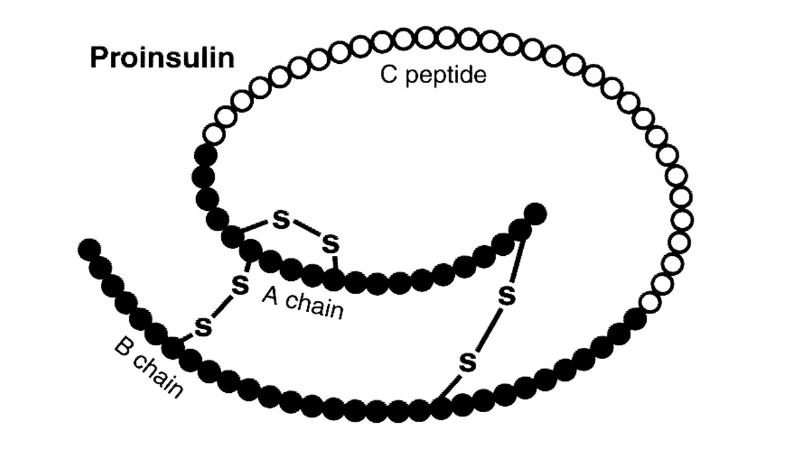
Insulin Structure

Slide 29
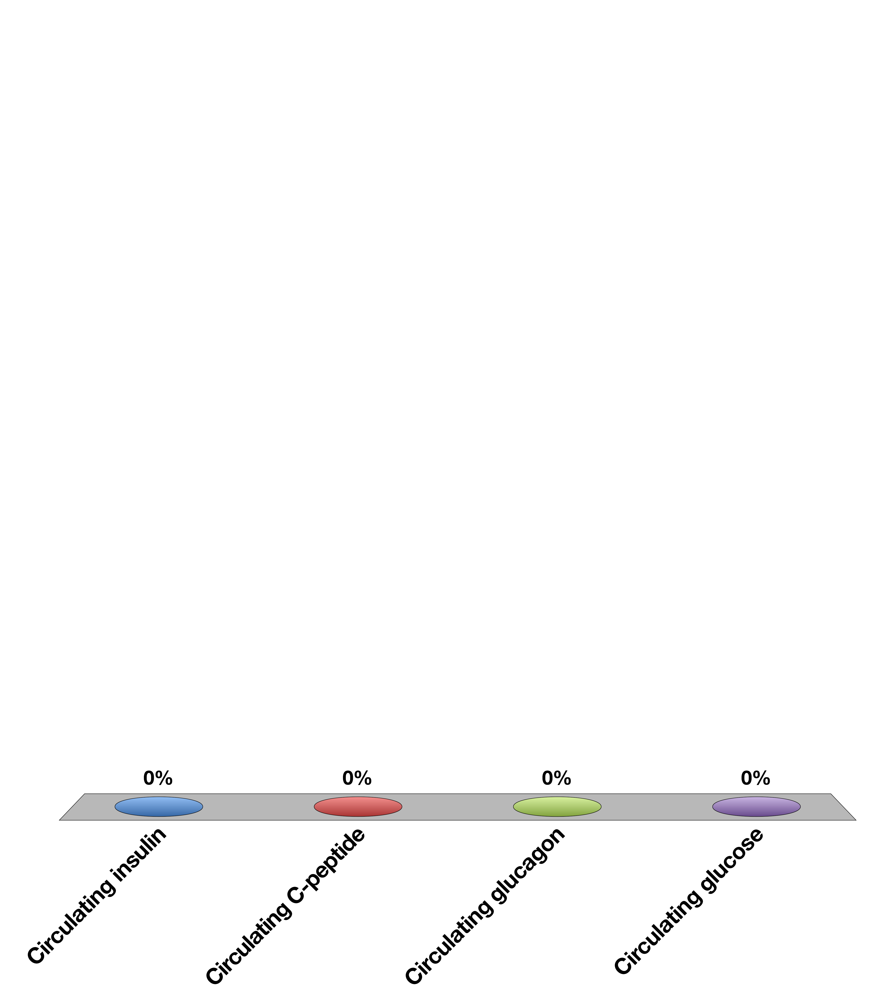
If you want to know insulin production in someone who is also taking injected insulin what would you measure?
insulin
C-peptide
Glucagon
Glucose
Response Counter
15

Slide 30
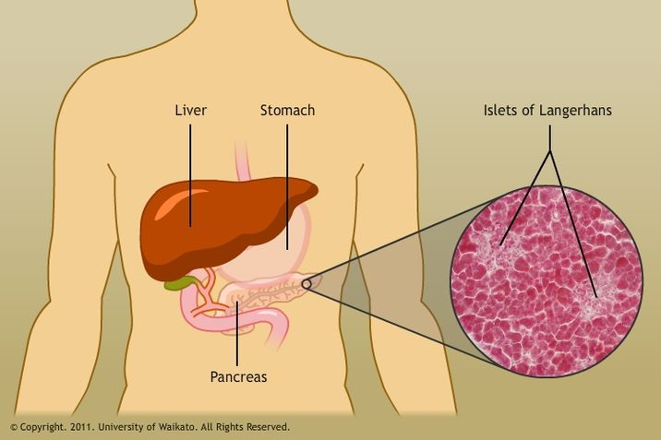
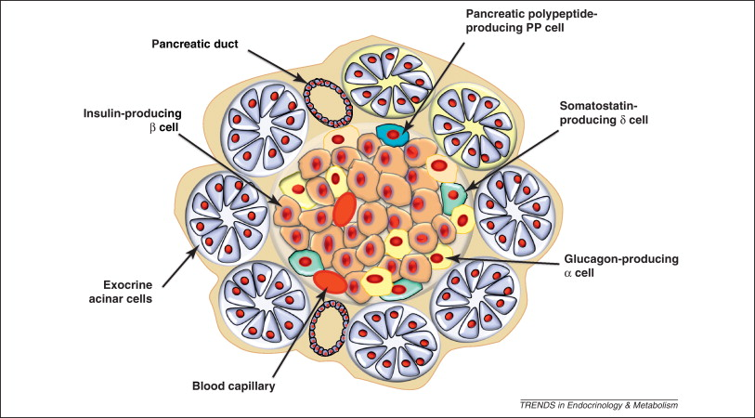
Pancreatic Anatomy
Cell | Hormone
Beta Cells | Insulin
Alpha Cells | Glucagon
Delta Cells | Somatostatin
Ductal Cells | Exocrine
S. Efrat, H. A. Russ, Making β cells from adult tissues, Trends Endocrinol. Metab. 23, 278–285 (2012).

Slide 31

Functions of Insulin
Promotes the uptake of glucose from the blood into muscle and adipose tissue.
Enhances the synthesis of glycogen and triglycerides in liver, adipose and muscle.
Insulin inhibits gluconeogenesis, or the production of glucose from non-glucose precursors such as amino acids and lipids.
Promote glucose breakdown and prevent lipid breakdown
Food
Circulating
Nutrients
(Glucose)
Glucose Production
Glucose Disposal
Insulin
Secretion
Nutrient Storage

Slide 32
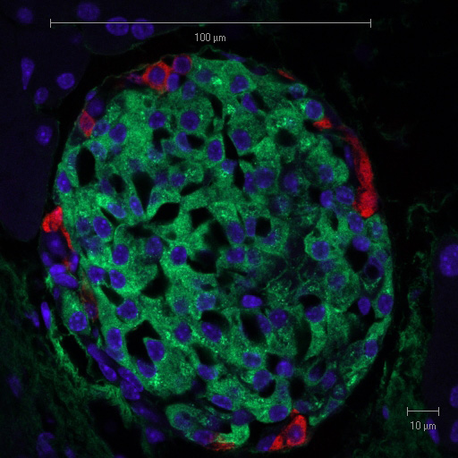
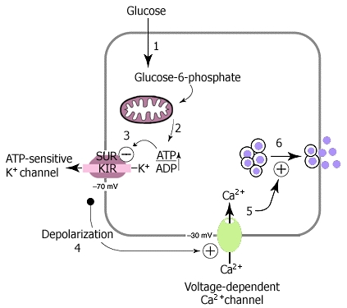
Insulin Secretion
Suckale and Solimena (2008) Frontiers in bioscience 13:7156-71
Pancreatic Islet with Glucagon and Insulin Staining
From Solilema Lab (http://en.wikipedia.org/wiki/Islets_of_Langerhans)
Notes:
Red is glucagon, green is insulin
What happens if you cannot secrete insulin from beta cells?
----- Meeting Notes (10/7/15 18:34) -----
Stop and ask which cells are alpha cells and which are beta cells

Slide 33
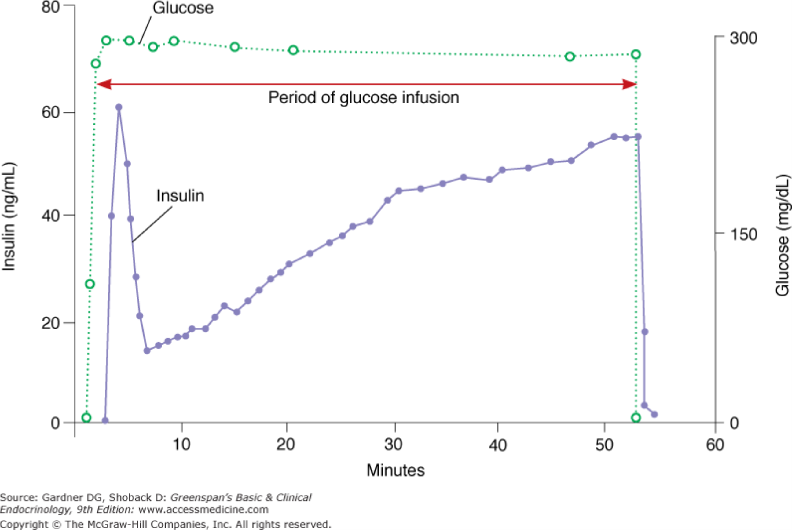
Biphasic Insulin Secretion

Slide 34
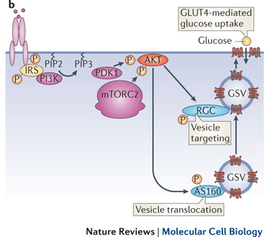
Insulin Stimulated GLUT4 Translocation
Leto and Saltiel Nat. Rev. MCB (2012)

Slide 35
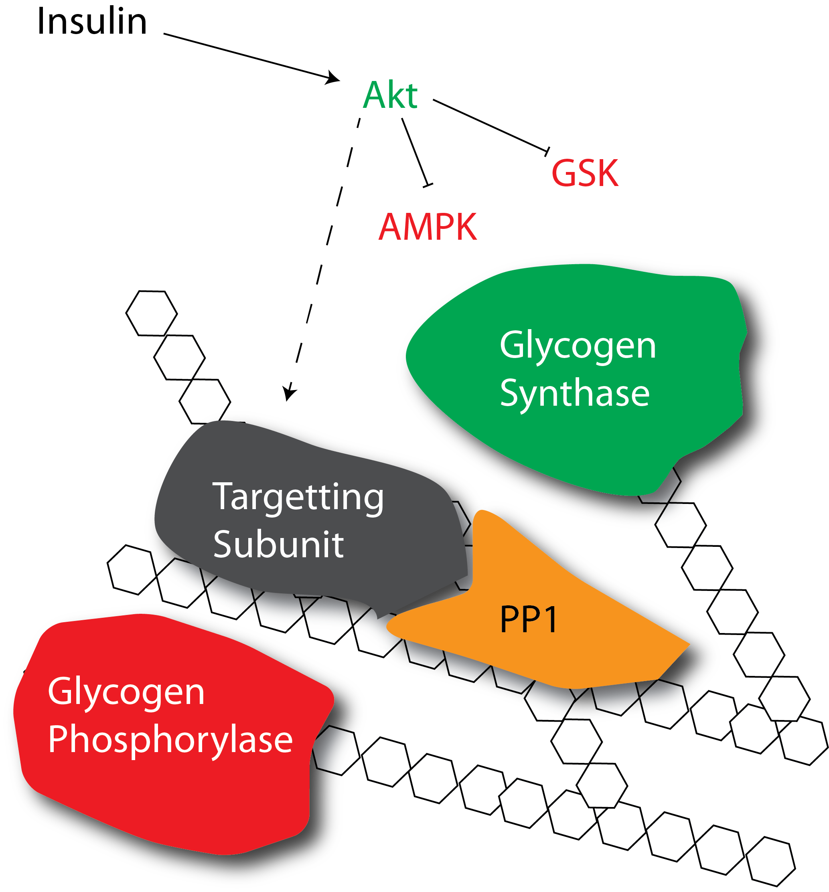
How does insulin promote glycogenesis?
Allosteric activation
Protein dephosphorylation
Notes:
First ask about which mediators are increased with insulin, or see what the allosteric activation of GS looks like

Slide 36
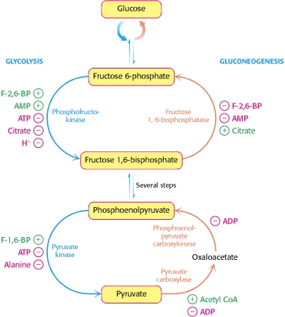
How does insulin reduce gluconeogenesis
FBPase is negatively regulated by F-2,6-BP
PEPCK and G6Pase are inhibited by insulin
Allosterically
Protein phosphorylation
Transcriptionally repressed
Notes:
First, does insulin promote or reduce gluconeogenesis

Slide 37
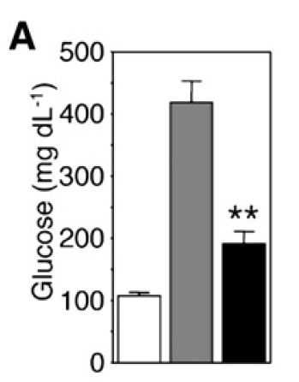
Transcriptional Regulation of Gluconeogenesis
Akt
PEPCK
G6Pase
P
Knockout
IR
IR +
FOXO
FOXO
P
P
Matsumoto et al. (2007) Cell Metab. 6:208-16

Slide 38
Talk amongst yourselves
Why would gluconeonesis be under transcriptional control, wheras glycogenesis is primarily under post-translational control
Hint: think about the speed of post-translational vs transcriptional responses

Slide 39
Mechanisms to Increase Blood Glucose

Slide 40
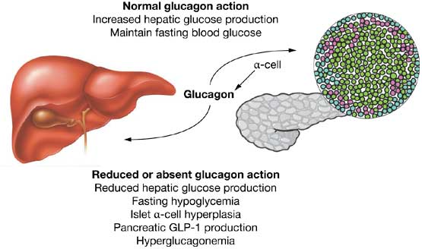
Glucagon Secretion
Secreted from alpha cells of the pancreas
Released by low blood sugar levels
Acts primarily on the liver not the muscle or fat tissues
Drucker (2013): Nat Rev Endo 1:22-31

Slide 41
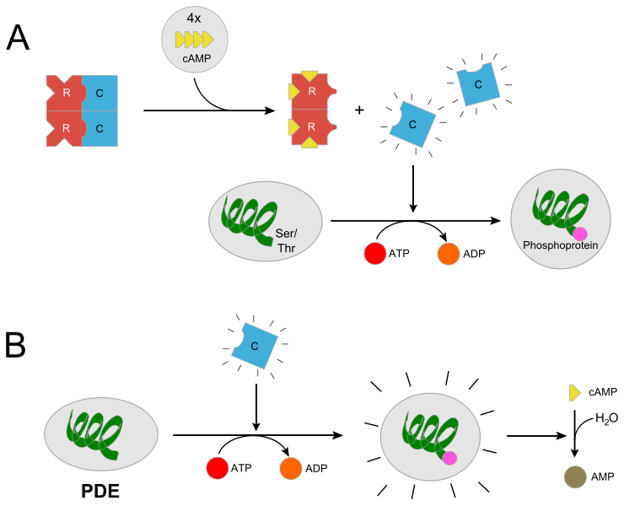
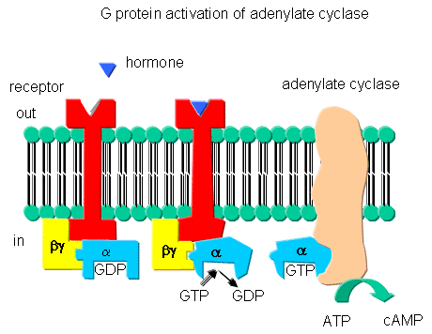
Glucagon Signaling
From http://biowiki.ucdavis.edu/Biochemistry/Signal_Transduction/Signal_Transduction_at_Cell_Membranes%3A_Protein_Kinases_and_Phosphotases
From http://en.wikipedia.org/wiki/Protein_kinase_A
Notes:
Potentially spend some time on earl sutherland’s experiments

Slide 42
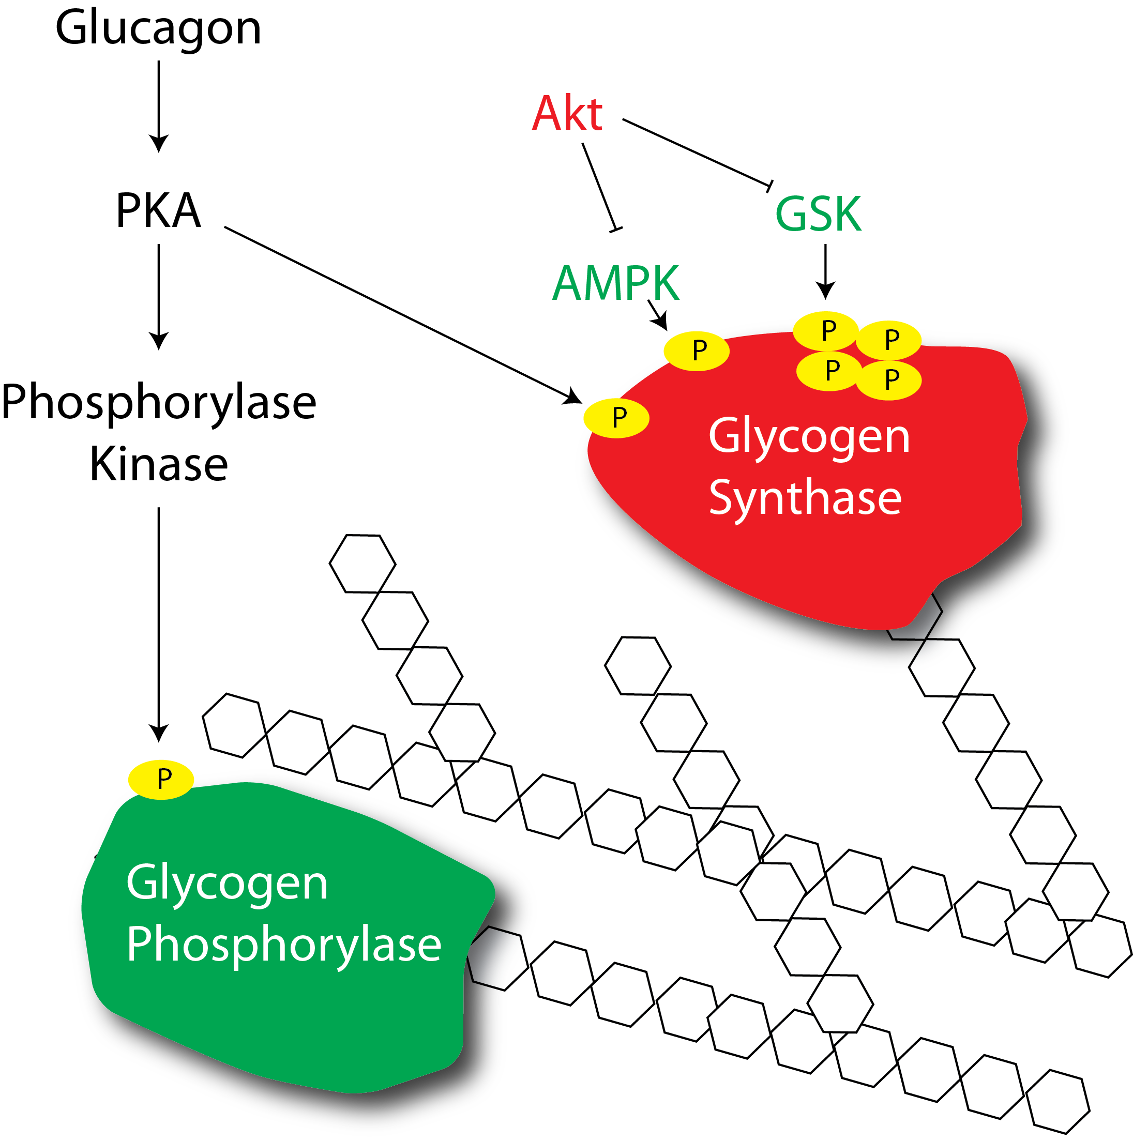
How does glucagon regulate glycogenolysis?

Slide 43
How does glucagon promote gluconeogenesis?
PKA
PFK-2
Notes:
Same as epinephrine
Ask, if we modulate F26P to promote gluconeogenesis, what would we want to do to it

Slide 44
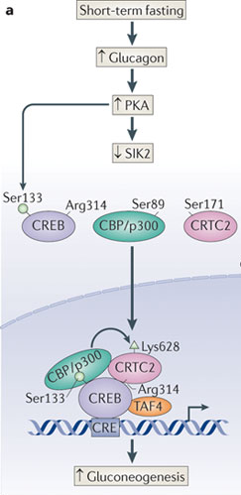
Transcriptional Regulation of Gluconeogenesis
More G6Pase, FBPase and PEPCK
Altajeros and Montminy (2008) Nat. Rev. MCB. 3:141-151

Slide 45
Glucagon and Insulin Clearance
Half lives in blood:
Insulin: about 5 minutes
Glucagon: about 5-10 minutes
Insulin degradation:
About 80 % in liver and kidney
Rest in other tissues (target tissues and non-target tissues)
Insulinase (insulin protease)
may act when insulin-insulin receptor is internalized
possible site of drugs to prolong insulin life and make limited supply last longer
Glucagon degradation:
Most occurs in the liver; perhipheral concentrations of Gg are low

Slide 46
Summary of Insulin and Glucagon
Insulin
Glucagon
Blocks gluconeogenesis
Blocks glycogenolysis
Promotes glycogenesis
Enhances glucose uptake
Promotes lipid storage
Promotes gluconeogenesis
Promotes glycolysis
Blocks glycogenesis

Slide 47
Secondary Regulation of Glucose Metabolism

Slide 48
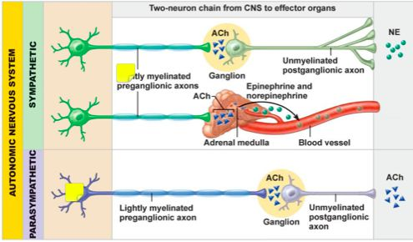
Nervous Control of Pancreatic Function
More Glucagon
Less Insulin
More Insulin
Less Glucagon
Notes:
Independent of blood glucose, what would exercise do to insulin and glucagon levels

Slide 49
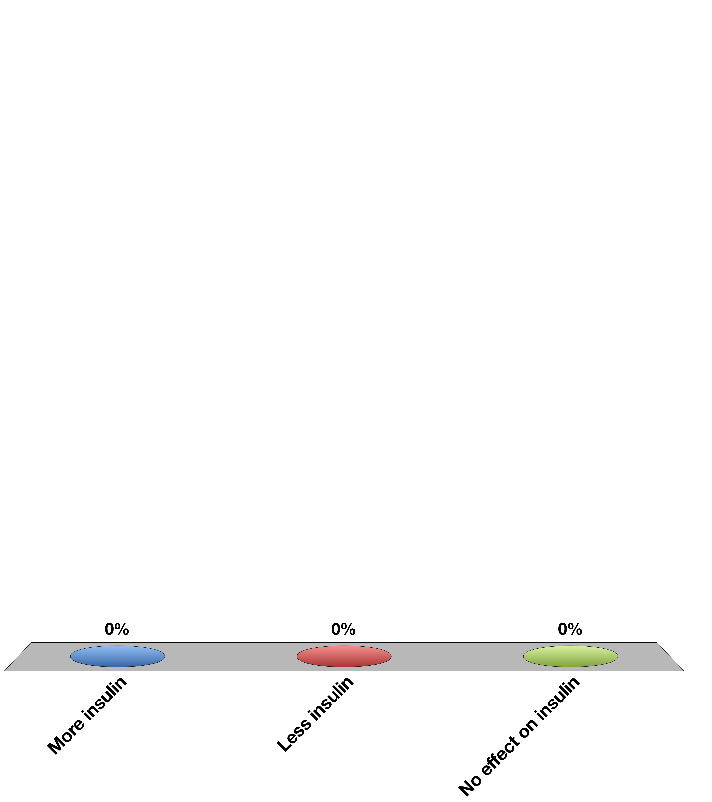
A tumor secretes adrenaline constantly, what are the effects
More insulin
Less insulin
No effect on insulin
15

Slide 50
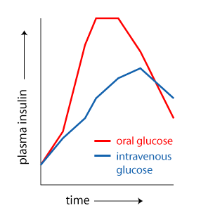
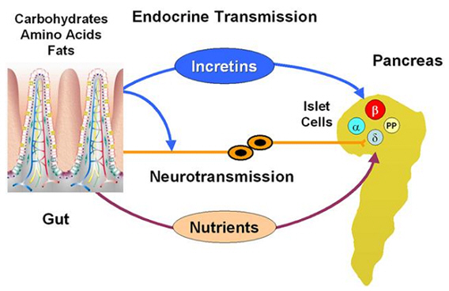
Incretins and Secondary Control of Insulin Secretion
GLP1/GIP1 both released from gut

Slide 51
Endocrine Control of Insulin Secretion
Acetylcholine
Adrenaline/
Noradrenaline
GLP-1
Glucagon
GIP
Insulin Secretion

Slide 52
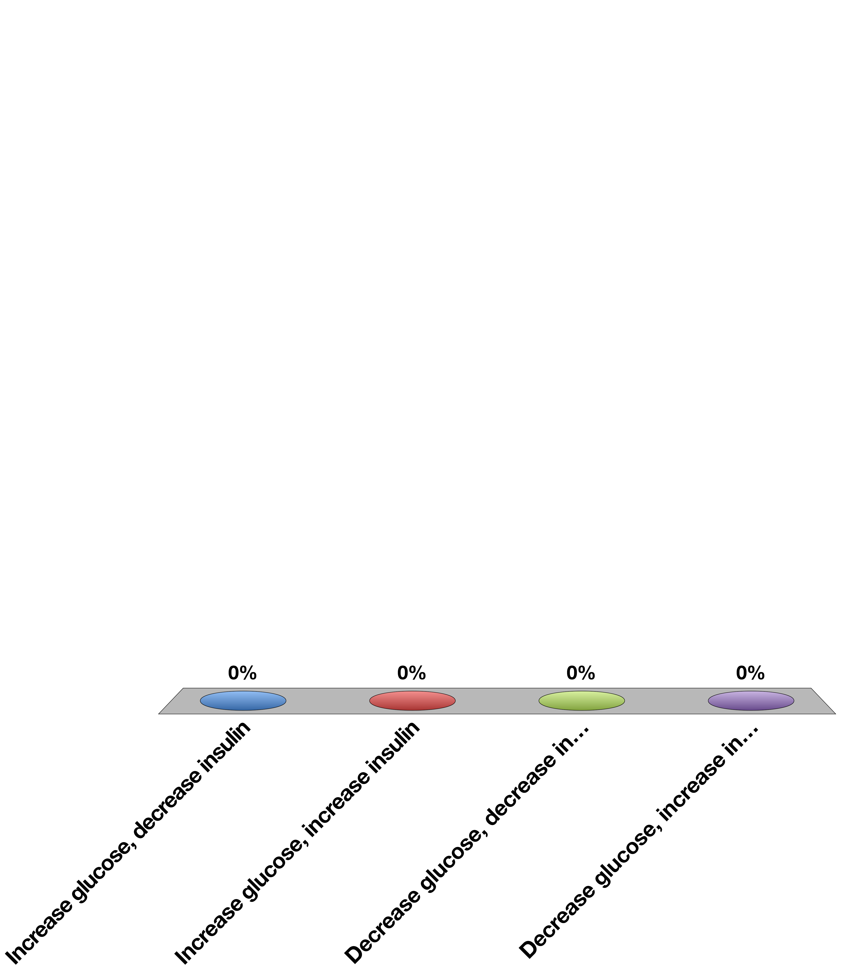
DPP-4 Degrades GLP-1 and GIP, What would it do to insulin and blood glucose?
Increase glucose, decrease insulin
Increase glucose, increase insulin
Decrease glucose, decrease insulin
Decrease glucose, increase insulin
Response Counter
30

Slide 53
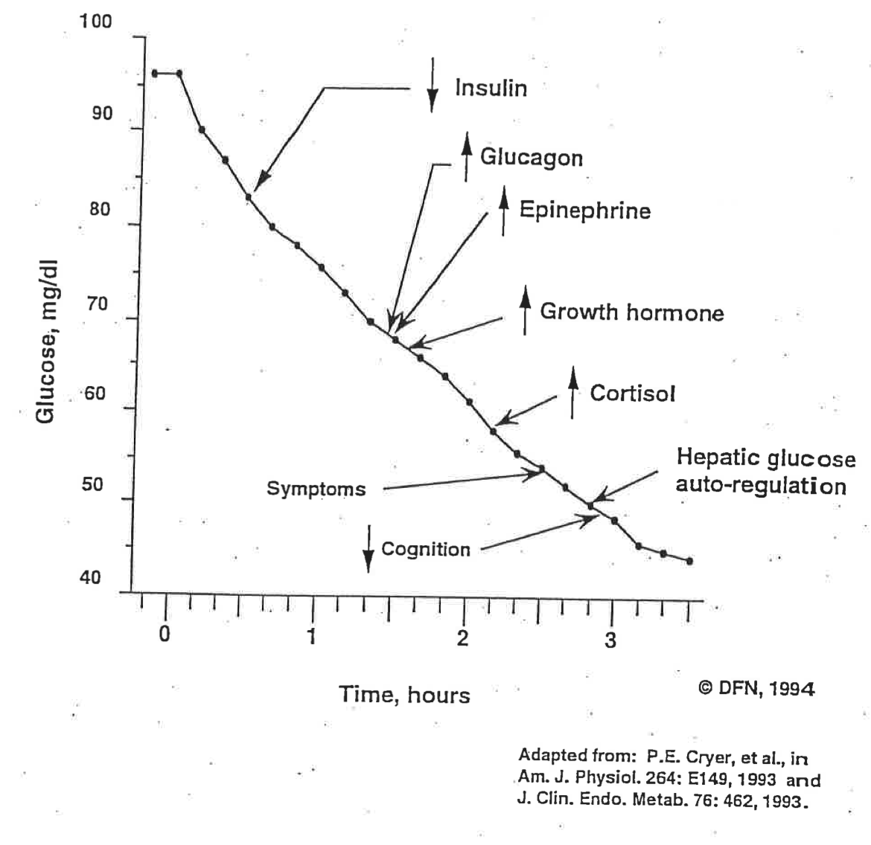
Long Term Glucoregulation

Slide 54
Oral glucose tolerance test
Draw what happens to glucose after a meal over time
Sketch out changes in glucagon, insulin and GLP-1
Sketch out a new one, for someone who is a type I diabetic (show insulin and GLP-1)
Sketch out a new one, for someone who is a type II diabetic (show insulin, glucagon and GLP-1)

Slide 55
Learning Objectives
Name the cell types of the Islets of Langerhans and name the hormones secreted by them.
Describe the main targets and functions of glucagon.
List the major factors that stimulate or inhibit glucagon and insulin.
Describe the important physiological roles of insulin.
List the major actions of insulin in muscle, adipose tissue, and liver.
Explain briefly the mechanism of glucose uptake into the muscle.
Name the tissues in which insulin facilitates glucose uptake and those in which insulin does not facilitate glucose uptake.
List the major factors that stimulate or inhibit insulin secretion.
Draw an oral glucose tolerance test (oGTT) (glucose, insulin, and glucagon levels) and and describe what is occurring and why. Explain how the two hormones act to promote glucose homeostasis in the plasma.
State which nutrient storages are preferably used for short-term regulation of energy metabolism if no nutrients are available from the GI tract.
Discuss the hormones involved, fuel storage capacity, fuel storage consumption, and glucose (or fatty acid) levels during 1) the postprandial period, 2) the post-absorptive period, 3) fasting.
List the insulin-counteracting hormones and their roles in glucose homeostasis. Discuss the hormones involved in minute-to-minute regulation and long-term regulation of glucose homeostasis.

